Slide 1

DEPARTMENT OF COMPUTER SCIENCE AND INFORMATION TECHNOLOGY
GURU GHASIDAS VISHWAVIDYALAYA BILASPUR (CG)
DEEPFAKE DETECTION USING
DEEP LEARNING
Presented by ---
NEERAJ KUMAR SAHU
Enroll : GGV/23/05027
Roll : 23072133
Guided by ---
Dr. Santosh Kumar Majhi

Slide 2
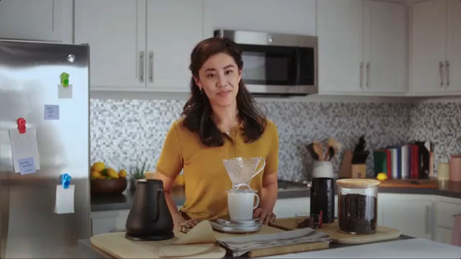
Introduction
Deep Fake Is A Technique For Human Image Synthesis Based On Artificial Intelligence.
Deep Fakes Are Created By Combing And Super-imposing Existing Images And Videos Onto Source Images Or Videos Using A Deep Learning Technique Known As Generative Adversarial Network.

Slide 3
Can we detect Deep fakes with naked eyes?

Slide 4
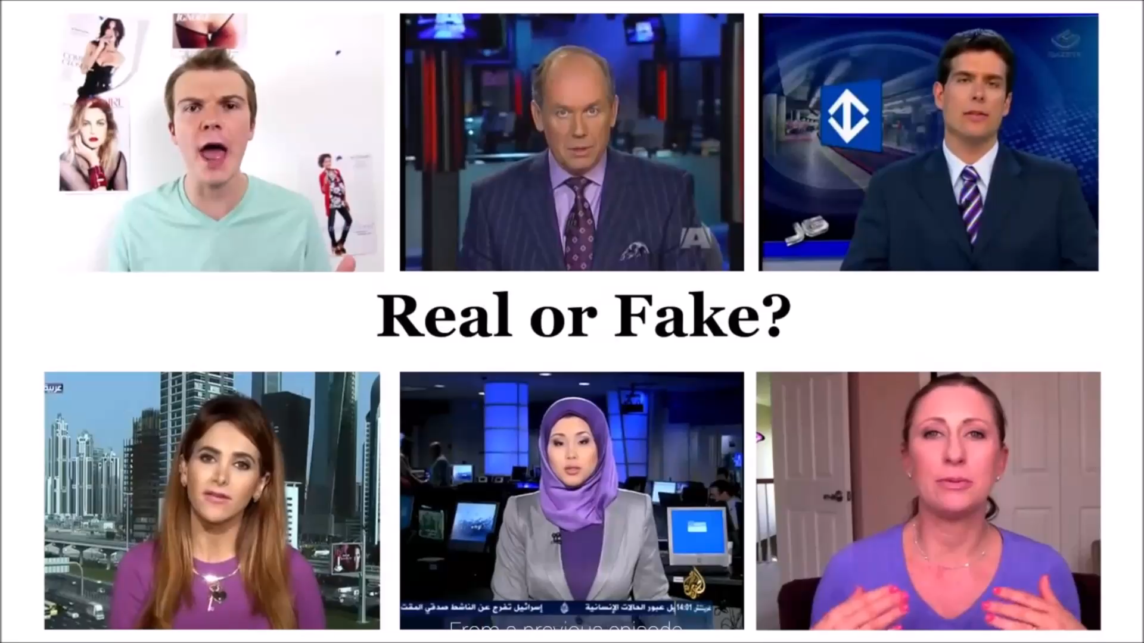

Slide 5
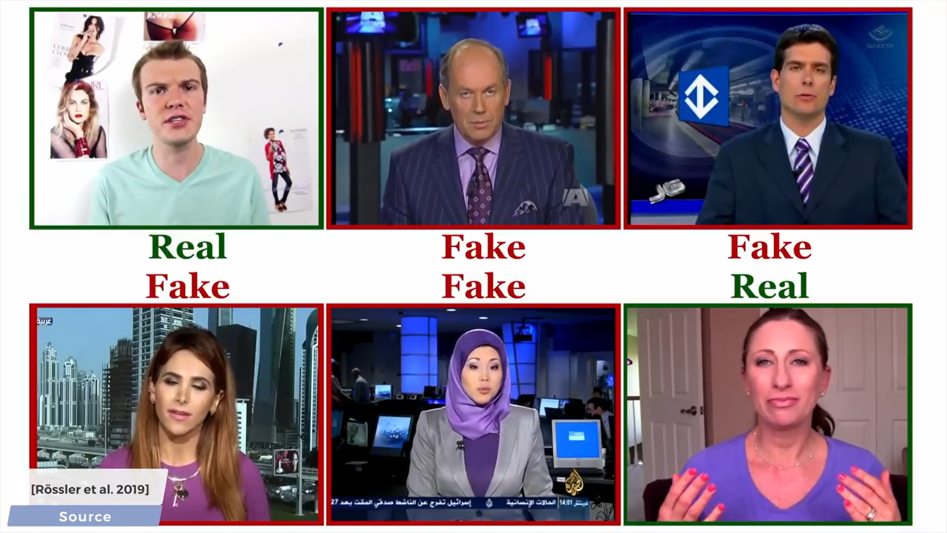

Slide 6
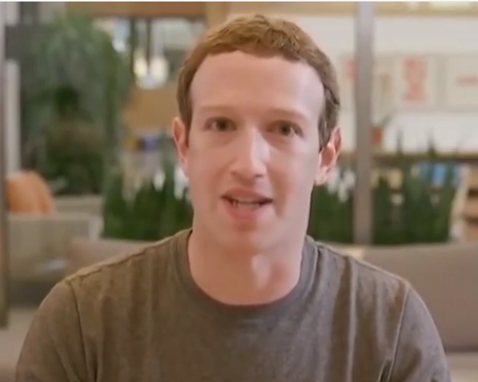

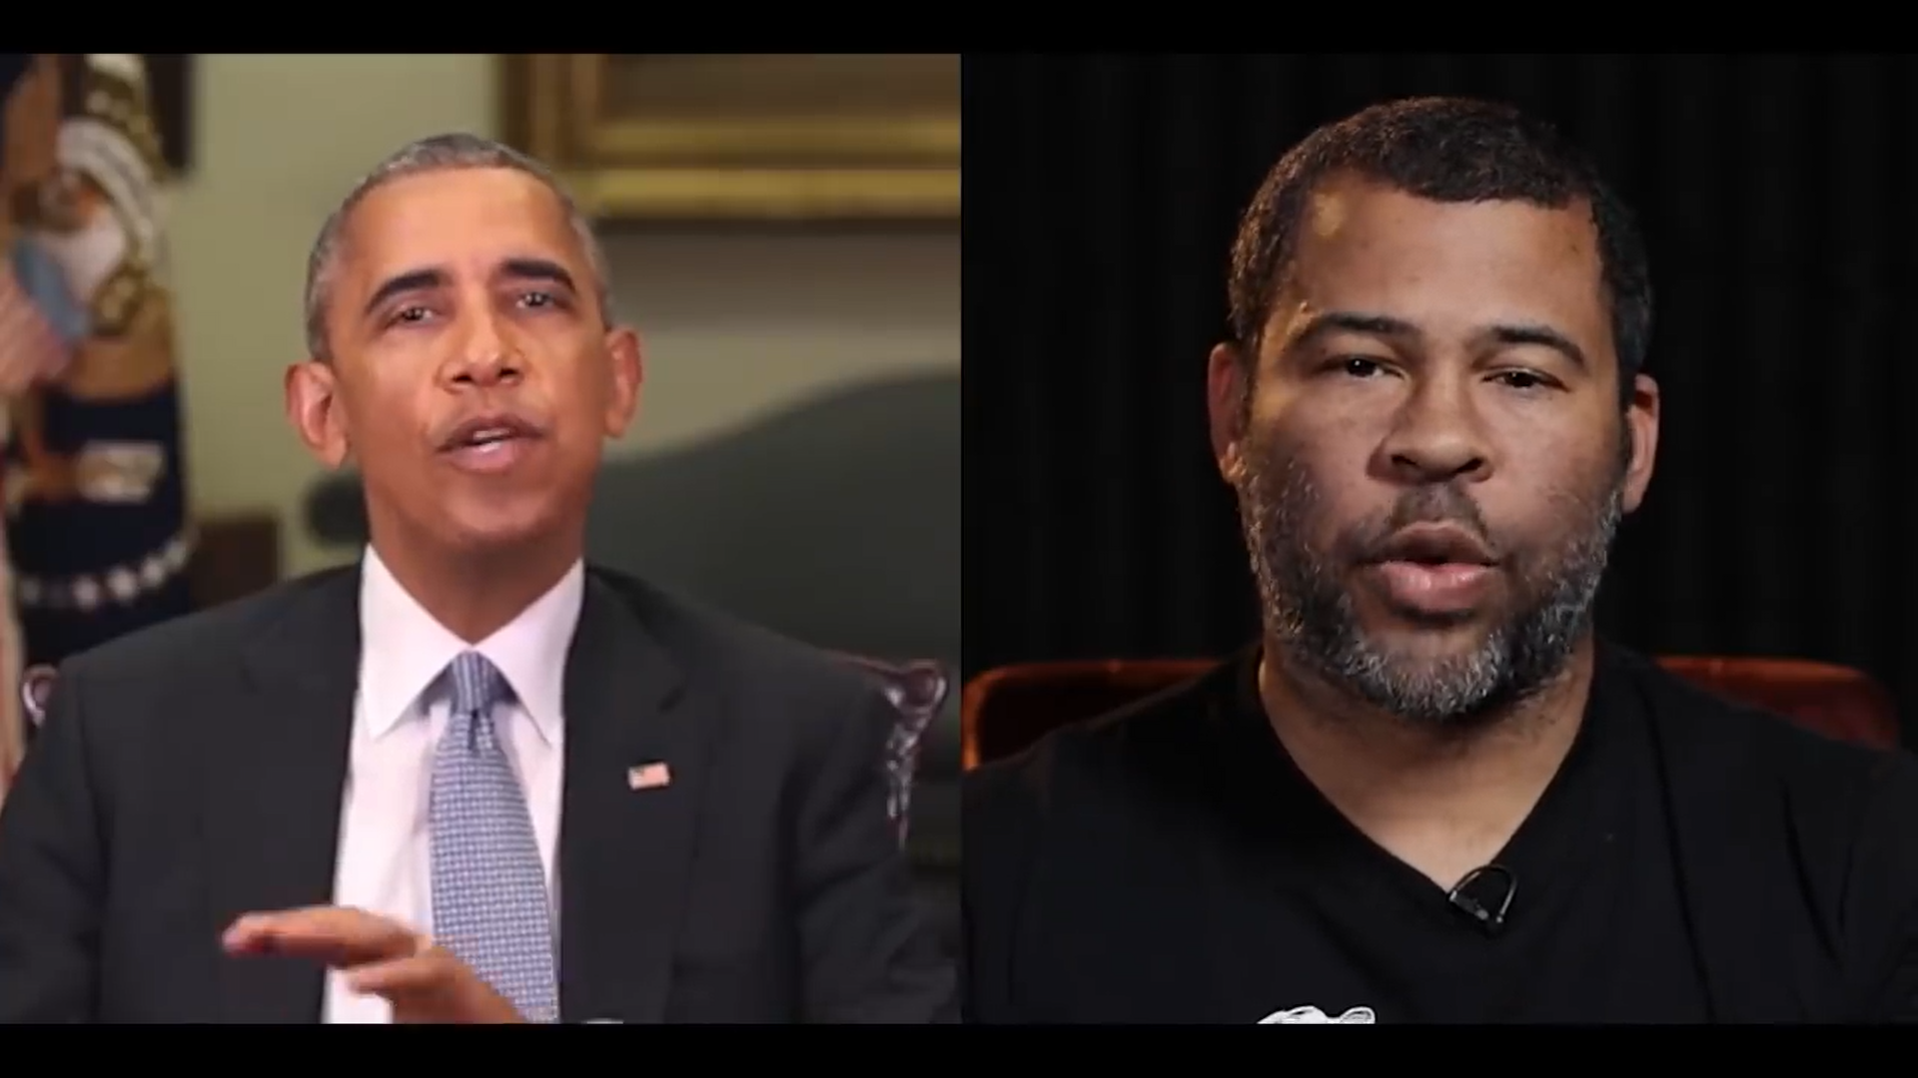
Why Deep Fake Detection ?
Fake News
Malicious hoaxes
Financial fraud
Celebrity unusual video
Politician videos

Slide 7
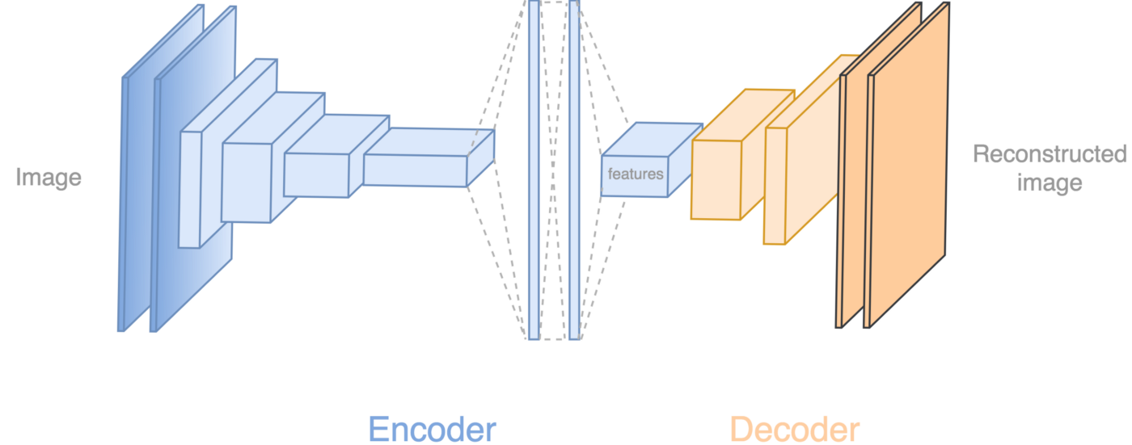
How Deep Fakes Are Created ?
Tools for deep fake creation.
Faceswap
Faceit
DeepFaceLab
DeepfakeCapsuleGAN
Large resolution facemasked

Slide 8
Methodology
1. Upload video using web interface.
2. Extract frames with OpenCV.
3. Detect and crop faces using face-recognition.
4. Preprocess: Resize to 224x224, normalize pixels.
5. Predict using MobileNetV2.
6. Aggregate results and display prediction with confidence.

Slide 9
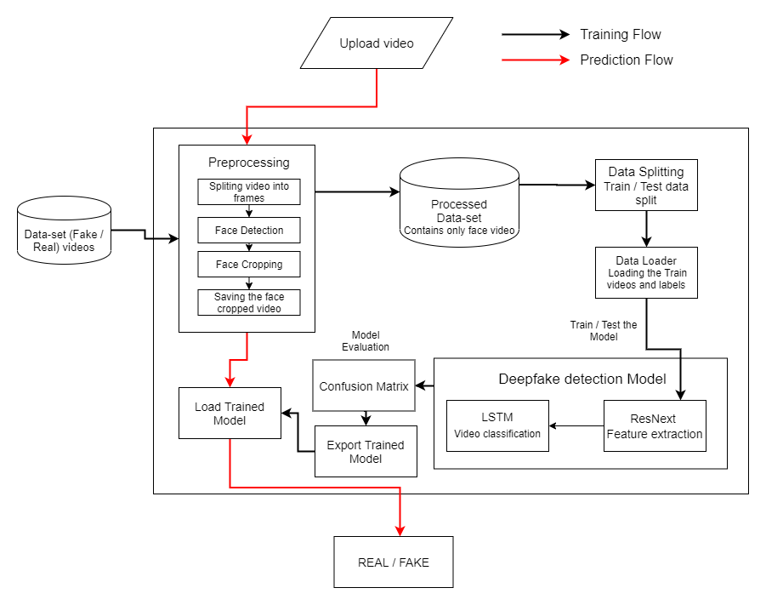

System Architecture
MobileNetV2

Slide 10
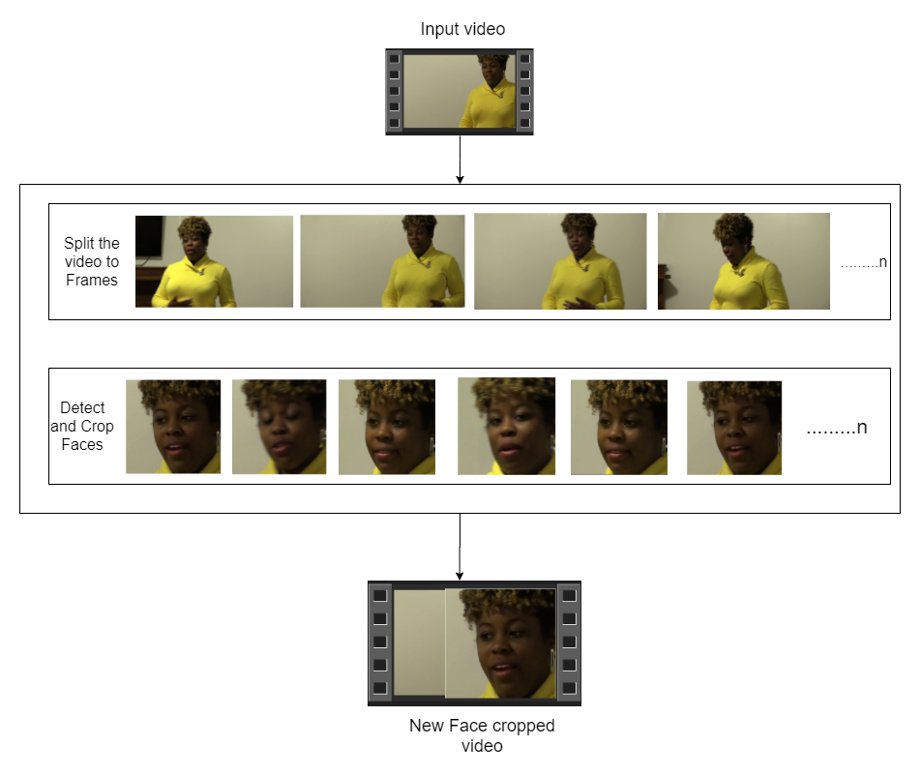

Pre-processing
SPLIT VIDEO INTO FRAMES
FACE DETECTION
5
4
3
2
1
CROPPING FACE
RESIZE IMAGE
SAVING THE FACE CROPPED IMAGES

Slide 11
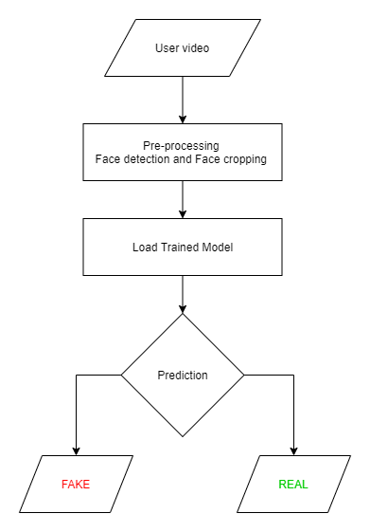
Prediction Workflow

Slide 12










Programming Languages
Python
HTML, CSS, JavaScript
Programming Frameworks
TensorFlow/Keras
Flask
Tools and Technologies
IDE
Google
Jupyter Notebook
Visual Studio Code

Slide 13
Applications
Social media moderation and misinformation control.
News/media verification before publishing.
Law enforcement and forensic video analysis.
Educational tools for deepfake awareness.
Browser plugins for real-time video scanning.

Slide 14
Future Scope
Full-body and voice-based deepfake detection.
Real-time mobile and browser app integration.
Model compression for low-resource deployment.
Larger and more diverse dataset inclusion.
Streaming and conferencing tool integration.

Slide 15
Conclusion
Built a lightweight, accurate deepfake detection system.
Web interface enables real-time public usage.
Model shows strong performance across datasets.
Supports ethical AI and secure digital content sharing.

Slide 16


